Slide 1


Why Choose Fontys ICT Infrastructure for a Career in Dev Ops

Slide 2
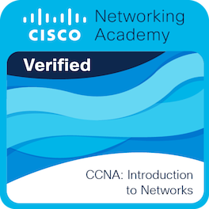
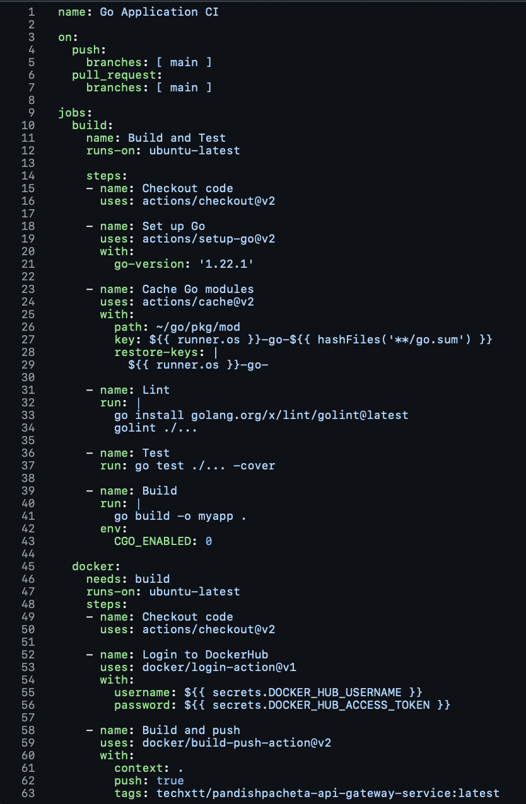
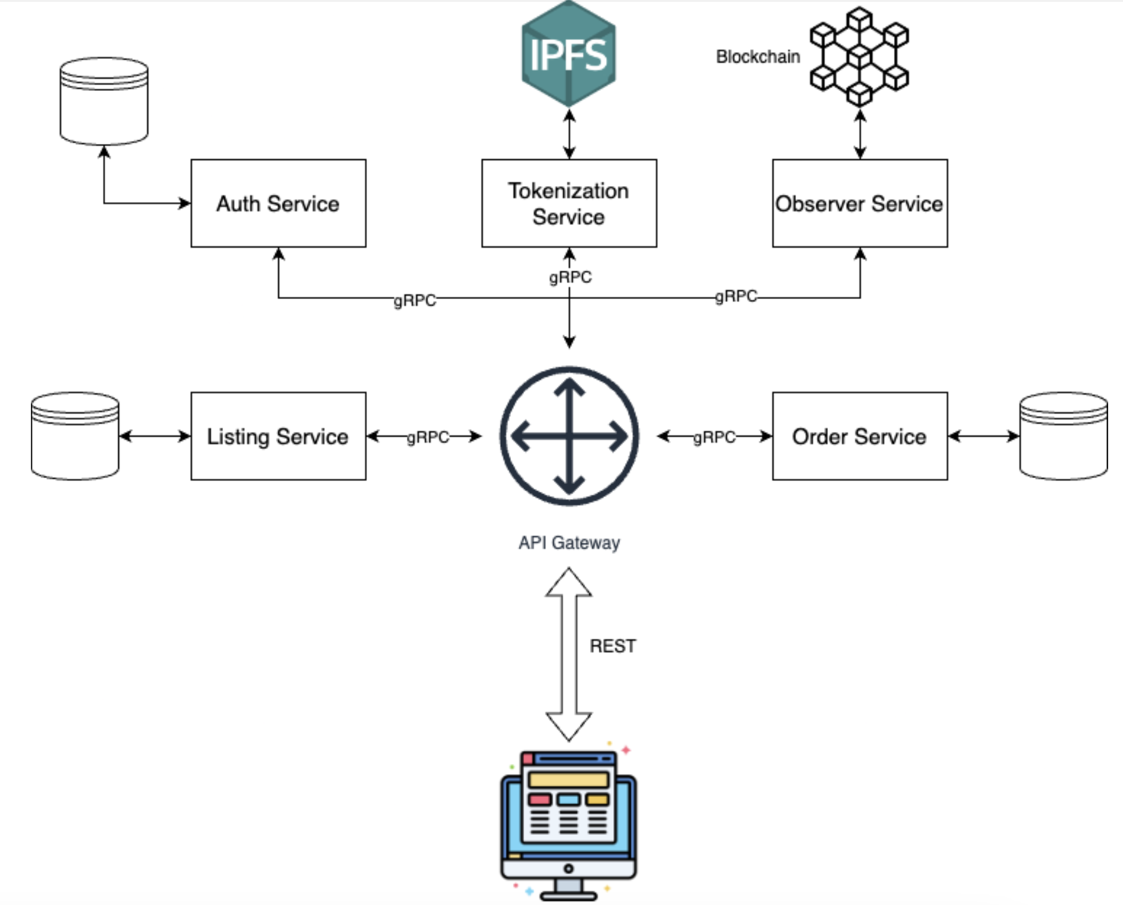
PERSONal Angle
Networking background
Experience with Dev Ops and CI/CD Pipelines
Excessive experience with Software

Slide 3
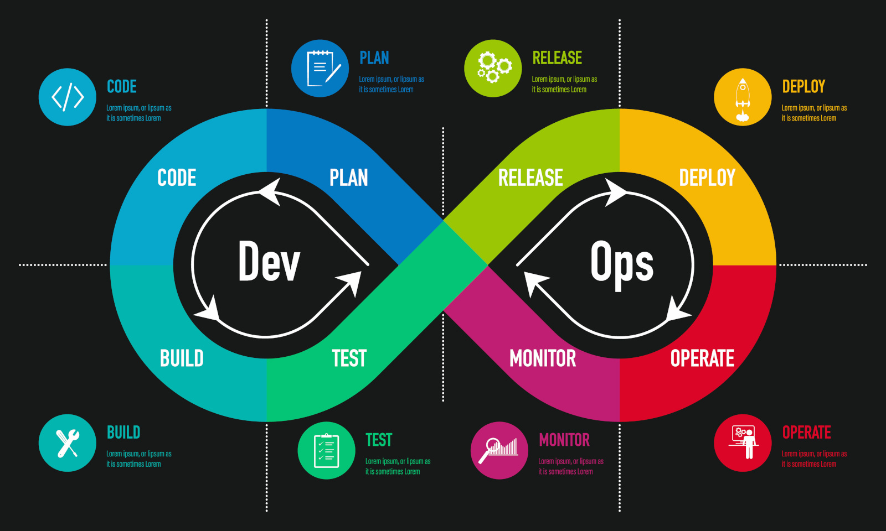
Introduction to DevOps
DevOps is a blend of Development and Operations, aimed at improving collaboration between software development and IT operations teams
It focuses on faster development cycles and reliable software deployment
The question is: Should you choose Fontys ICT Infrastructure or Software Engineering to succeed in DevOps?

Slide 4

Focus on Infrastructure and Operations
ICT Infrastructure focuses on the backend systems that power DevOps, including servers, networks, cloud environments, and automation tools.
In DevOps, understanding infrastructure is crucial for building efficient, scalable systems that support the development lifecycle.
Key Areas in ICT Infrastructure:
Networking, servers, cloud infrastructure (AWS, Azure, Google Cloud)
Automation tools (Ansible, Terraform)
System administration (Linux, Windows)
Virtualization and containerization (Docker, Kubernetes)

Slide 5

Tools and Automation Knowledge
DevOps thrives on automation to streamline operations and ensure smooth deployments.
ICT Infrastructure teaches critical tools for automating system management:
CI/CD pipelines with Jenkins, GitLab CI
Automation tools like Puppet, Chef
Monitoring with tools like Prometheus, Grafana
These tools are essential for creating a seamless development-to-deployment pipeline, automating repetitive tasks, and reducing errors.

Slide 6

Infrastructure as Code (IaC)
Infrastructure as Code (IaC) is a key DevOps principle that allows developers to manage and provision infrastructure through code.
In ICT Infrastructure, you’ll learn how to automate and manage entire infrastructures using code-based tools like Terraform and CloudFormation.
IaC enables scalable, version-controlled infrastructure that integrates smoothly with software development practices.

Slide 7

Operational Expertise for DevOps
DevOps is not just about deploying software but also about keeping systems stable and minimizing downtime.
The ICT Infrastructure program equips you with operational expertise in:
System Monitoring: Keeping systems healthy by monitoring performance.
Disaster Recovery: Ensuring backups and high availability.
Performance Tuning: Optimizing systems to handle growing loads.
You’ll learn to ensure that the infrastructure is reliable, scalable, and always operational.

Slide 8

Cloud Computing and Virtualization
DevOps is closely tied to cloud computing, and ICT Infrastructure provides a strong focus on managing cloud-based environments.
You’ll gain expertise in platforms like AWS, Azure, Google Cloud, which are essential for deploying and managing applications at scale.
Virtualization and containerization (e.g., Docker and Kubernetes) are core DevOps technologies, and ICT Infrastructure covers these in-depth, preparing you for real-world environments.

Slide 9
Why Not Software Engineering?
Software Engineering focuses more on application development, coding, and algorithms, which is essential but only one side of DevOps.
If your DevOps focus is on writing code and building tools, Software Engineering is valuable.
However, ICT Infrastructure is better suited for those who want to manage the infrastructure, automate systems, and handle operations.

Slide 10
Summary: Why Choose ICT Infrastructure?
In-depth focus on infrastructure and systems crucial to DevOps.
Automation tools and practices central to CI/CD pipelines and operational efficiency.
Training in Infrastructure as Code (IaC), virtualization, and cloud management, which are key components of DevOps workflows.
Gain operational expertise to ensure reliable, scalable systems that support development efforts.

Slide 11

Thank You! Any Questions?

